Slide 1
MICRO CREDIT LOAN DEFAULTER’S Prediction (Using ML) done by: s.padmavathi

Slide 2
TABLE OF CONTENTS
ML Model Development and Evaluation
About the Project
01
03
Analytics of the Business Problem
02
04
Conclusion
Introduction
What is Micro Finance?
Micro Finance Institutions and Telecom Service.
Business Problem – Micro credit loan defaulters.
Future of Micro Finance
Problem Identification.
Listing of ML Models.
Processing the Data-set for Training and Testing.
Evaluation of ML Models.
Hyper Tuning of the ML Model.
Final Results.
What is Analytical problem framing?
Analytics of the business problem.
Hardware Requirements.
Software Requirements.
Tools, Libraries and Packages used.
Data sources.
Data Pre-Processing.
Key Findings and Learning outcomes
Limitations and future work

Slide 3
—What is Micro Finance?
“ the provision of financial assistance and insurance services to an individual or an eligible client either directly or through a group mechanism for an amount , not exceeding the minimal amount fixed by the financial sector per individual for small and tiny enterprises ,agriculture, allied activities or other prescribed purposes”.

Slide 4
Micro Finance Institutions and Telecom Service
A Microfinance Institution (MFI) is an organization that offers financial services to low income populations.
MFS becomes very useful when targeting especially the unbanked poor families living in remote areas with not much sources of income.
The Microfinance services (MFS) provided by MFI are Group Loans, Agricultural Loans, Individual Business Loans and so on.
Many microfinance institutions (MFI), experts and donors are supporting the idea of using mobile financial services (MFS) which they feel are more convenient and efficient, and cost saving, than the traditional high-touch model used since long for the purpose of delivering microfinance services.
Though, the MFI industry is primarily focusing on low income families and is very useful in such areas, the implementation of MFS has been uneven with both significant challenges and successes.
They understand the importance of communication and how it affects a person’s life, thus, focusing on providing their services and products to low income families and poor customers that can help them in the need of hour.

Slide 5
Business Problem – Micro credit loan defaulters
The MFS are collaborating with an MFI to provide micro-credit on mobile balances to be paid back in 5 days. The Consumer is believed to be “defaulter” if he deviates from the path of paying back the loaned amount within the time duration of 5 days. For the loan amount of 5 (in Indonesian Rupiah), payback amount should be 6 (in Indonesian Rupiah), while, for the loan amount of 10(in Indonesian Rupiah), the payback amount should be 12(in Indonesian Rupiah).

Slide 6
Future of Micro Finance
Although the MFI are providing MFS, some critical reasons make it hard for the MFI to continue in funding the MFS. The increase in the defaulters is one of the main reasons for the MFI to face such hardships.
Thus the only way to maintain the current MFS programme is to reduce the defaulter’s rate. For this we have to know the probability of the customer paying the loan back.
For that we have to find the history of the customer’s account in recharging, repaying the loan etc.
Here the main objective for this project is to find the defaulters by using technology services. So we will be using Machine Learning Models for doing the same.

Slide 7
ANALYTICS OF THE BUSINESS PROBLEM
What is Analytical problem framing?
Analytics of the business problem.
Hardware Requirements.
Software Requirements.
Tools, Libraries and Packages used.
Data sources.
Pre-Assumptions.
Data Pre-Processing

Slide 8
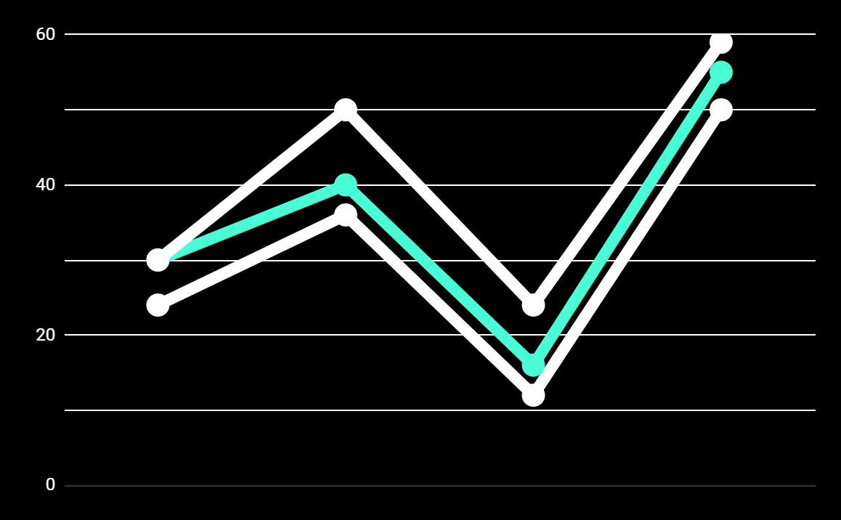
What is Analytical problem framing?
Analytic problem framing involves translating the business problem into terms that can be addressed analytically via data and modeling. It’s at this stage that you work backwards
from the results / outputs you want to the data/inputs you’re going to need, where you identify potential drivers and hypotheses to test, and where you nail down your assumptions.
Analytic problem framing is the antithesis of merely working with the ready-to-hand data and seeing what comes of it, hoping for something insightful. Typically, the process moves on from here to data collection, cleansing and transformation,
Methodology selection and model building, never to return. But if you’re willing to borrow and use a concept from complex adaptive systems – maps and models – you can make repeat use
of this stage to improve your overall outcome.

Slide 9
Analytics of the business problem
As discussed above we need to build a ML Model to predict the repayment of the loan by the customer. For that we need some analytical data’s. So we have to find the customer history with the telecom industry. The attributes should contain the recharge intervals , loan intervals, repayment intervals, date, area of the customer for forming a zone, time period taken for the customer to take the next loan etc.,

Slide 10
Requirements
Requirements :
A mid level computer that runs on Intel i3/i5/i7 or A10/A11/M1 or ryzen 3/5 or any other equivalent chipset and a suitable processor.
Software Requirements:
Windows / Linux /Mac OS
Tools, Libraries and Packages used:
Tool: Anaconda Navigator,Jupyter Notebook
Libraries and Packages:
Numpy,Pandas,Matplotlib,Seaborn

Slide 11
Data sources
The sample data is provided to us from our client database.It is hereby given to you for this exercise.
In order to improve the selection of customers for the credit, the client wants some predictions that could help them in further investment and improvement in selection of customers.
The given data-set can be used to build a ML Model which can be used to predict in terms of a probability for each loan transaction, whether the customer will be paying back the loaned amount within 5 days of insurance of loan.
In this case, Label “1” indicates that the loan has been payed i.e. Non-defaulters, while, Label “0” indicates that the loan has not been payed i.e. defaulters.

Slide 12
Data Pre- Processing
Collection of basic statistical data.
Exploratory data analysis.
Checking for correlation with target.
Checking for skewness in the data-set.
Checking for outliers.

Slide 13
Collection of basic statistical data
Try to gather insights about the data.
Check for null values.
Draw connections between min,max&mean.
Check for unwanted attributes.
Check for data types.

Slide 14
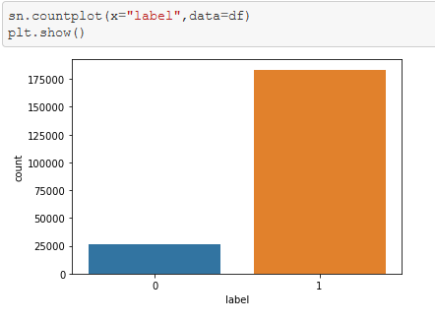
Exploratory Data Analysis
Observation:
1."0”: user failed to paid back the credit amount within 5 days & "1”: user paid back the credit amount within 5 days.
2. It seems the defaulters are lesser than the people repaying the loan amount.

Slide 15
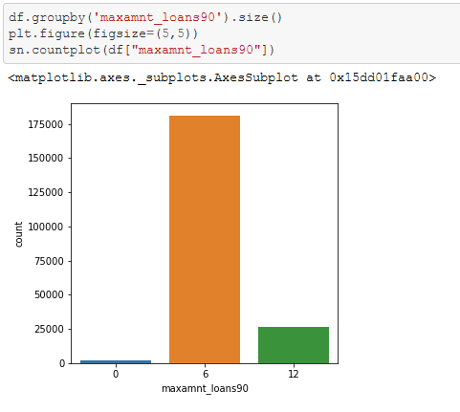
Exploratory Data Analysis
Observation:
People who took 5 Indo Rupiah loans are more than people who took 10 Indo Rupiah loans, on the other hand more than 98% of people who are using this telecom seems to have took this Micro finance loan.

Slide 16
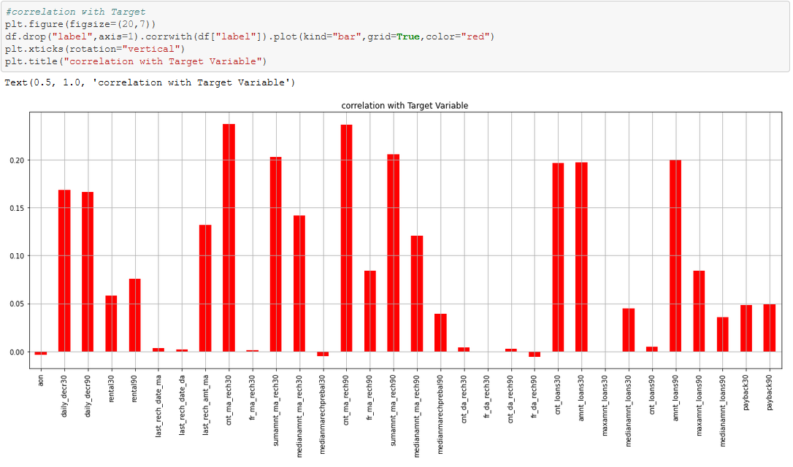
Checking for correlation with target
Observation:
Here, in this above chart we could see that the columns "aon","medianmarechprebal30", & "fr_da_rech30" seems to have a negative correlation with our Target variable. Thus dropping this column would give us much better Data-set to build a model.

Slide 17
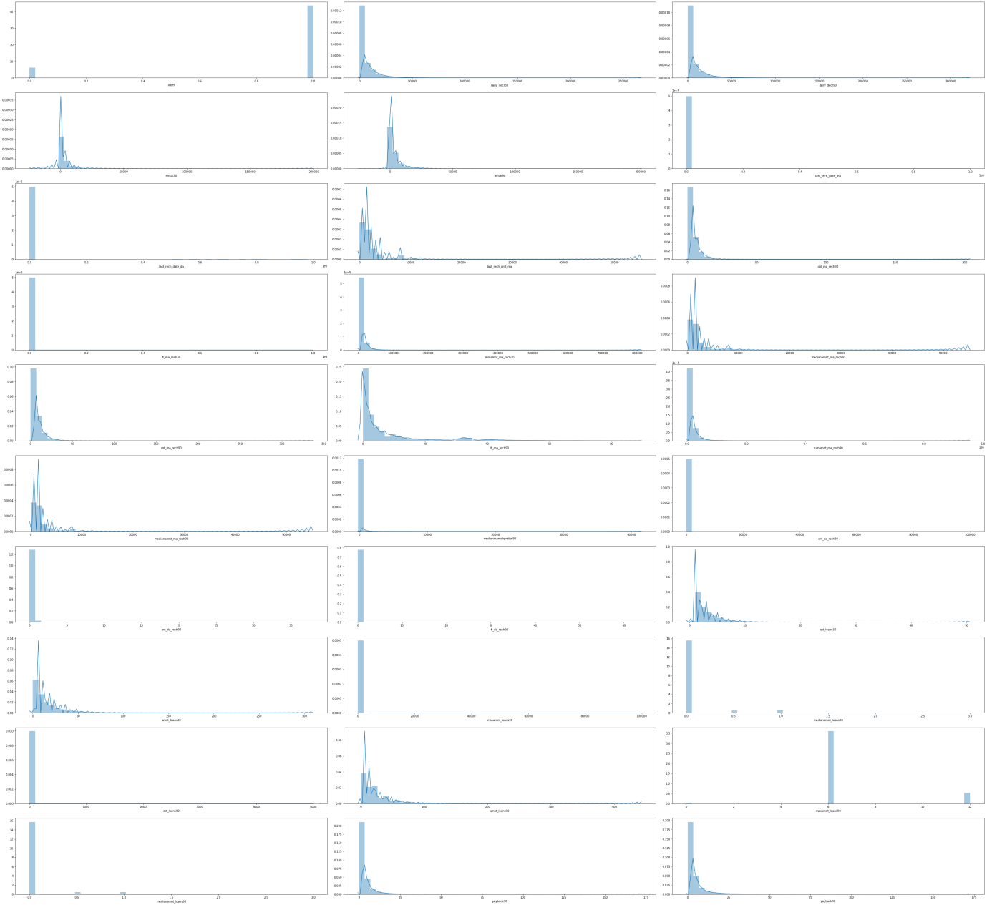
Checking for Skewness

Slide 18
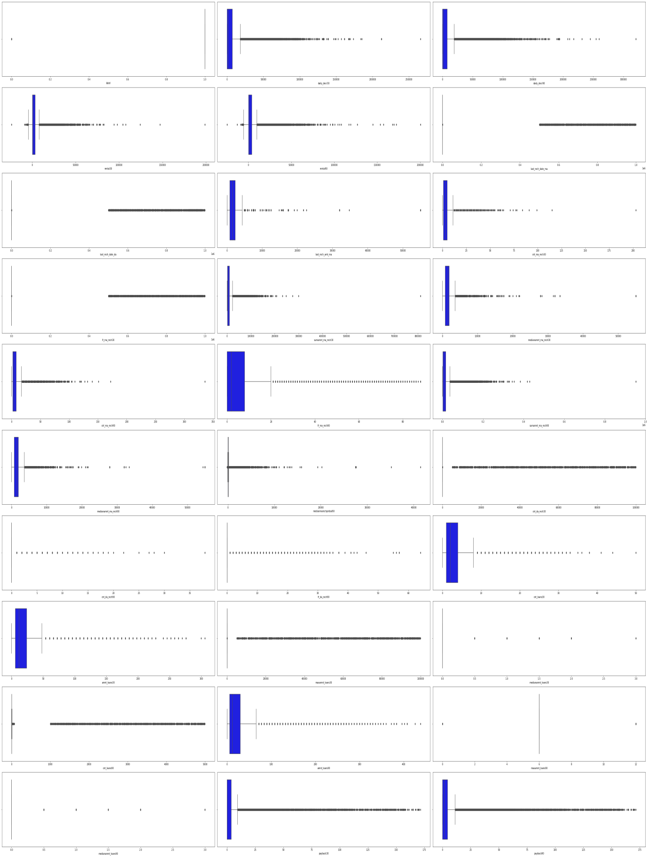
Checking for outliers

Slide 19
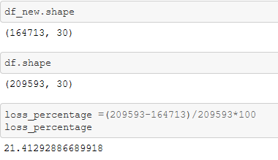
Checking for removal of outliers
Observations:
We can see that the loss percentage is around 21.4%. But the Project Requirements suggest that we should not lose more than 7-8% of the data. As per the pre-processing engineering we should remove this kind of outliers from the data-set. But removing the 21.4% of loss will result in voiding the project requirements.
Thus we will continue without removing the outliers.

Slide 20
ML Model Development and Evaluation
Problem Identification
The given objective for our project is to predict the instance that whether the people will pay the loan taken by them or not. That instance is labeled in the Target variable as 1's and 0's where 1's are customers paying the loan on time and 0's are customers not paying the loan on time. This is a classic case of "Classification". So we will use different type of classifying machine learning algorithms to build a prediction model.
Listing of ML Models
For this given Objective we will use the following Machine Learning Models.
1.Logistic Regression.
2.RandomForestClassifier.
3.NAIVE BAYES(GaussianNB).
4.KNeighborsClassifier.
5.DecisionTreeClassifier.
6.SVC.

Slide 21
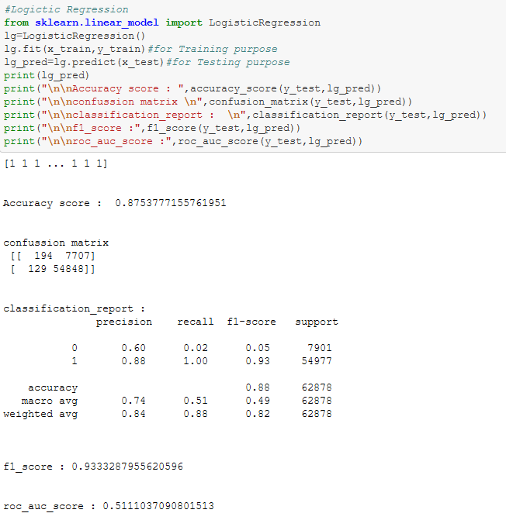
Logistic Regression.
Here in Logistic Regression we have acquired a Accuracy score of 87.5%. The F1 score is 93. This is a decent ML model. But we will try to infer from all the other ML Models too

Slide 22
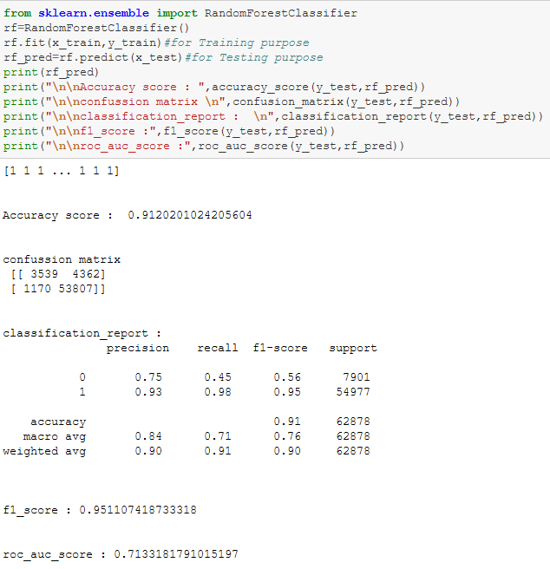
RandomForestClassifier
Here from the RandomForestClassifier we got an accuracy score of 91.2%. which implies that it is performing well with the given data-set.

Slide 23
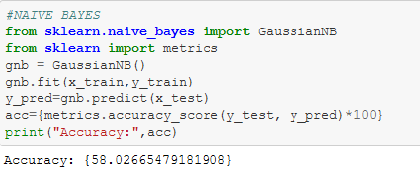
NAVIE BAYES (GaussianNB)
Here in Navie Bayes (Gaussian NB) we got an accuracy range of 58.02%, which is pretty much low compared to all other ML Models.

Slide 24
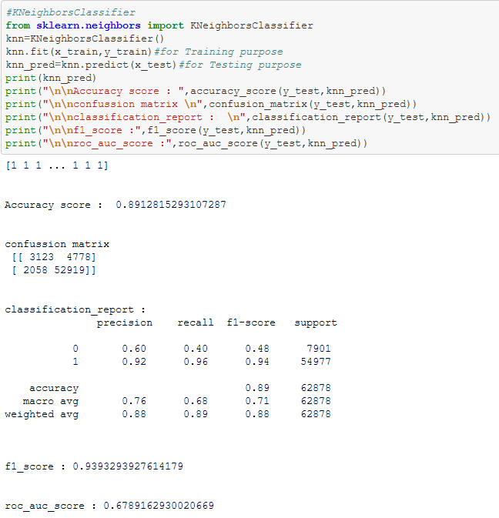
KNeighborsClassifier
In KNeighborsClassifier we got an accuracy score 89.12%.

Slide 25
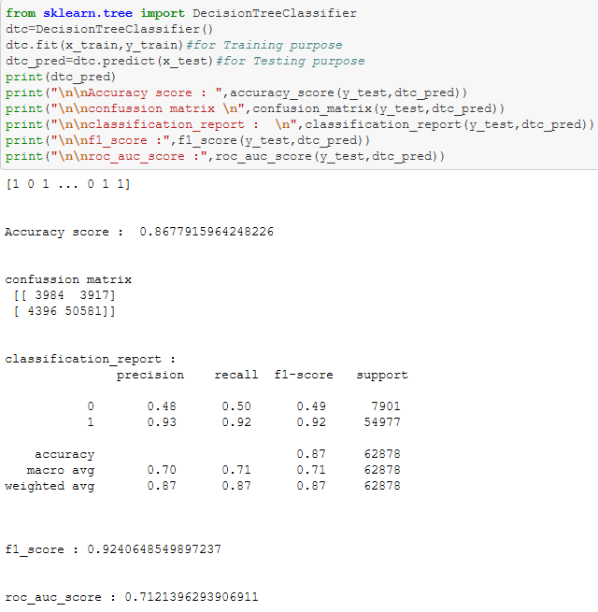
DecisionTreeClassifier
Here using DecisionTreeClassifier we got an accuracy score of 86.77%. Along with a F1 score of 92.

Slide 26
SVC
Here we have got 87.65% using SVC. Along with an F1 score of 93.

Slide 27
KEY OBSERVATION:
From the above results we can visibly see that the “RandomForestClassifier" is having a better accuracy score of 91% along with a promising f1 score and classification report.Now we will try to tune the "RandomForestClassifier" model using Hyper parameters for a better accuracy score.

Slide 28
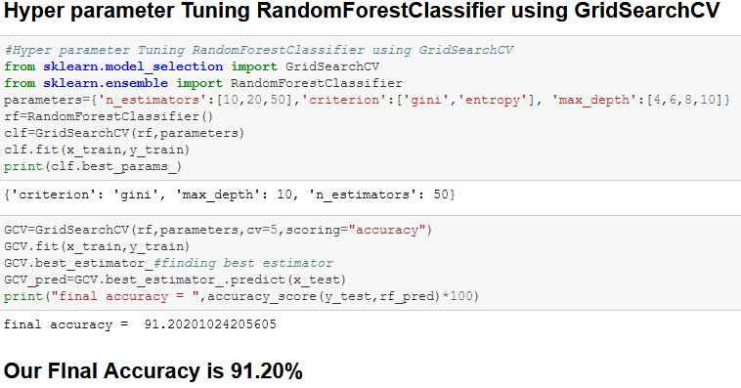
Hyper Tuning of the ML Models.

Slide 29
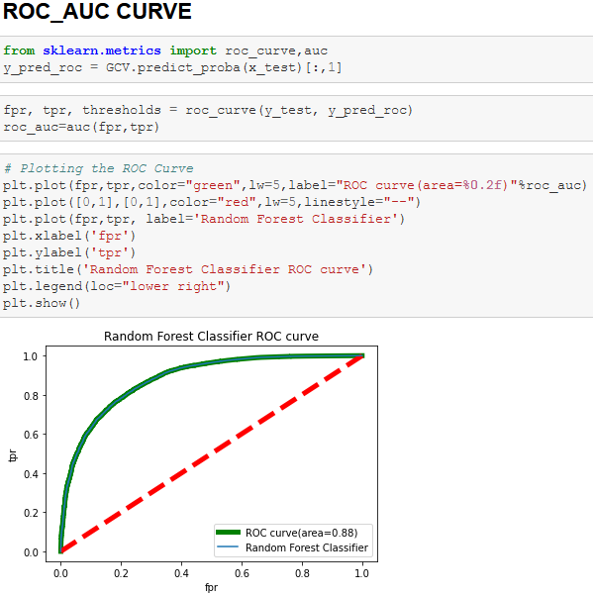
ROC_AUC CURVE.

Slide 30
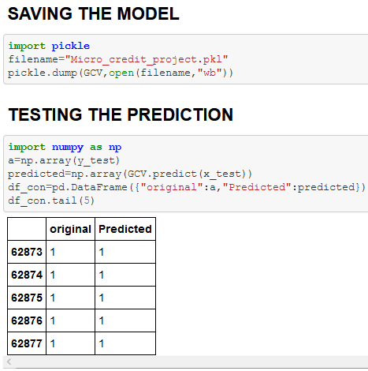
FINAL RESULTS

Slide 31
CONCLUSION
KEY FINDINGS AND LEARNING OUTCOMES
Microfinance program of this telecom company has a positive impact on the lives of the poor. It is not a question of whether or not the poor need information technology, but rather what the appropriate technology is that will enable them to escape poverty. Whatever the technology, it needs to be seen as a device with real and relevant benefits, not as an extravagance. Microfinance has been found an operational tool for lifting the poor by providing them financial services to maintain communication and to keep in touch with their dear ones.
But the raise in defaulters not paying the loan back is the biggest nightmare for the Telecom industry. Because increase in defaulters will result in lesser funding for the MFS. Thus in order to save the MFS the telecommunication industry turns towards the technology asking for help.
So we technology services build certain ML Models to predict the defaulters and to reduce the MFS to regular defaulters which reduces the financial risk for the MFI.
Here during our ML Model building exercise we took the sample data provided by the client and followed a series of analysis in order to make the data more efficient. For that we used exploratory data analysis, correlation chart, various types of visualizations in order to help us find the gist of the core problem. On this process we have built an efficient ML Model with the help of Random forest classifier which has an accuracy rate of 91.2%.
Thus in future the telecom industry can use this ML Model to predict the defaulters and may control the financial stability of the MFI. Making this the actual people who may need the MFS will get them on time without any delays.

Slide 32
CONCLUSION
LIMITATIONS AND FUTURE WORK
When we were handling the outliers there is a whopping 21% of outliers were present in the data-set. But data is a precious thing. We can’t afford to lose data’s. Also the client requirement was not to lose more than 7-8% of the data. Thus we continued building a ML model without removing the outliers.
This in turn affects the accuracy of the ML model directly. The more the outliers the less efficient the Machine learning model will be. So the data-set should be engineered in a better way so that there won’t be any loss of the data.
Also most of the attributes doesn’t give a plausible relation with the target value during the EDA. Visualization of such instance seems to be a hardship. Thus more relatable attributes would help us to build a more efficient MLM.

Slide 33


